Slide 1
Development of an integrated approach for introducing conservation agricultural practices to the tribal communities of Odisha, India
Jacqueline Halbrendt
Dept. of Natural Resources & Environmental Management
University of Hawaii at Manoa, Honolulu, Hawaii, USA

Slide 2
Introduction: Study Area
Kendujhar District, Odisha State in Eastern India
Odisha is one of the poorest states in India
Primarily consisting of tribal villages of 30-100 households
Predominantly smallholder, subsistence farmers with <2 ha land per household
Rely on low input, rain-fed rice and maize based cropping systems

Slide 3
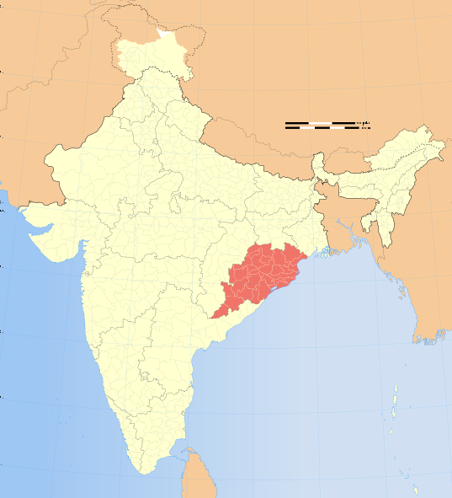
Study Area: Odisha State, India
Kendujhar District

Slide 4
Objectives
The purpose of this research was to evaluate the feasibility of introducing Conservation Agriculture Production Systems (CAPS) to tribal farmers in Kendujhar through:
Establishing maize-based experimental trials to assess yield and soil effects of reduced tillage, intercropping, & cover cropping
Socio-economic surveying of farm households to establish current farming practices, production rates, marketing patterns, & income
Integrating objectives (i) and (ii) to conduct economic analysis of potential farm benefits and costs of introducing CAPS into current farming systems

Slide 5
Methodology: Experimental Trials
In June 2010, a field trial was established on a fallow terrace at the Odisha University of Agriculture and Technology (OUAT) research station in Kendujhar
Treatments were based on a Rapid Rural Assessment, farmer focus groups, and consultation with OUAT experts to verify that the treatments would be appropriate for future replication on farmer fields
8 treatments were used to assess 3 factors:
(1) Reduced tillage
(2) Maize/cowpea intercrop (Zea mays/Vigna unguiculata)
(3) Post-harvest cover crop (Horse gram, Macrotyloma uniflorum)

Slide 6
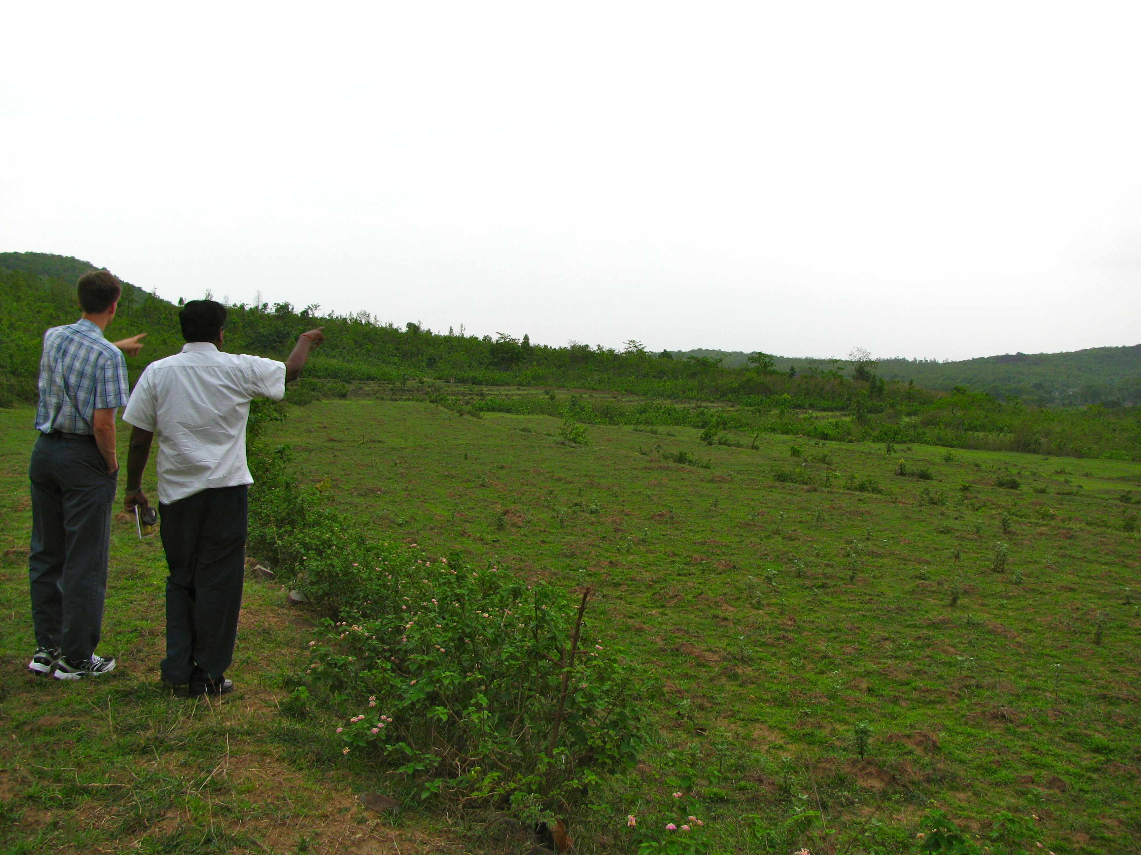
Experimental field, prior to implementation (2010)

Slide 7
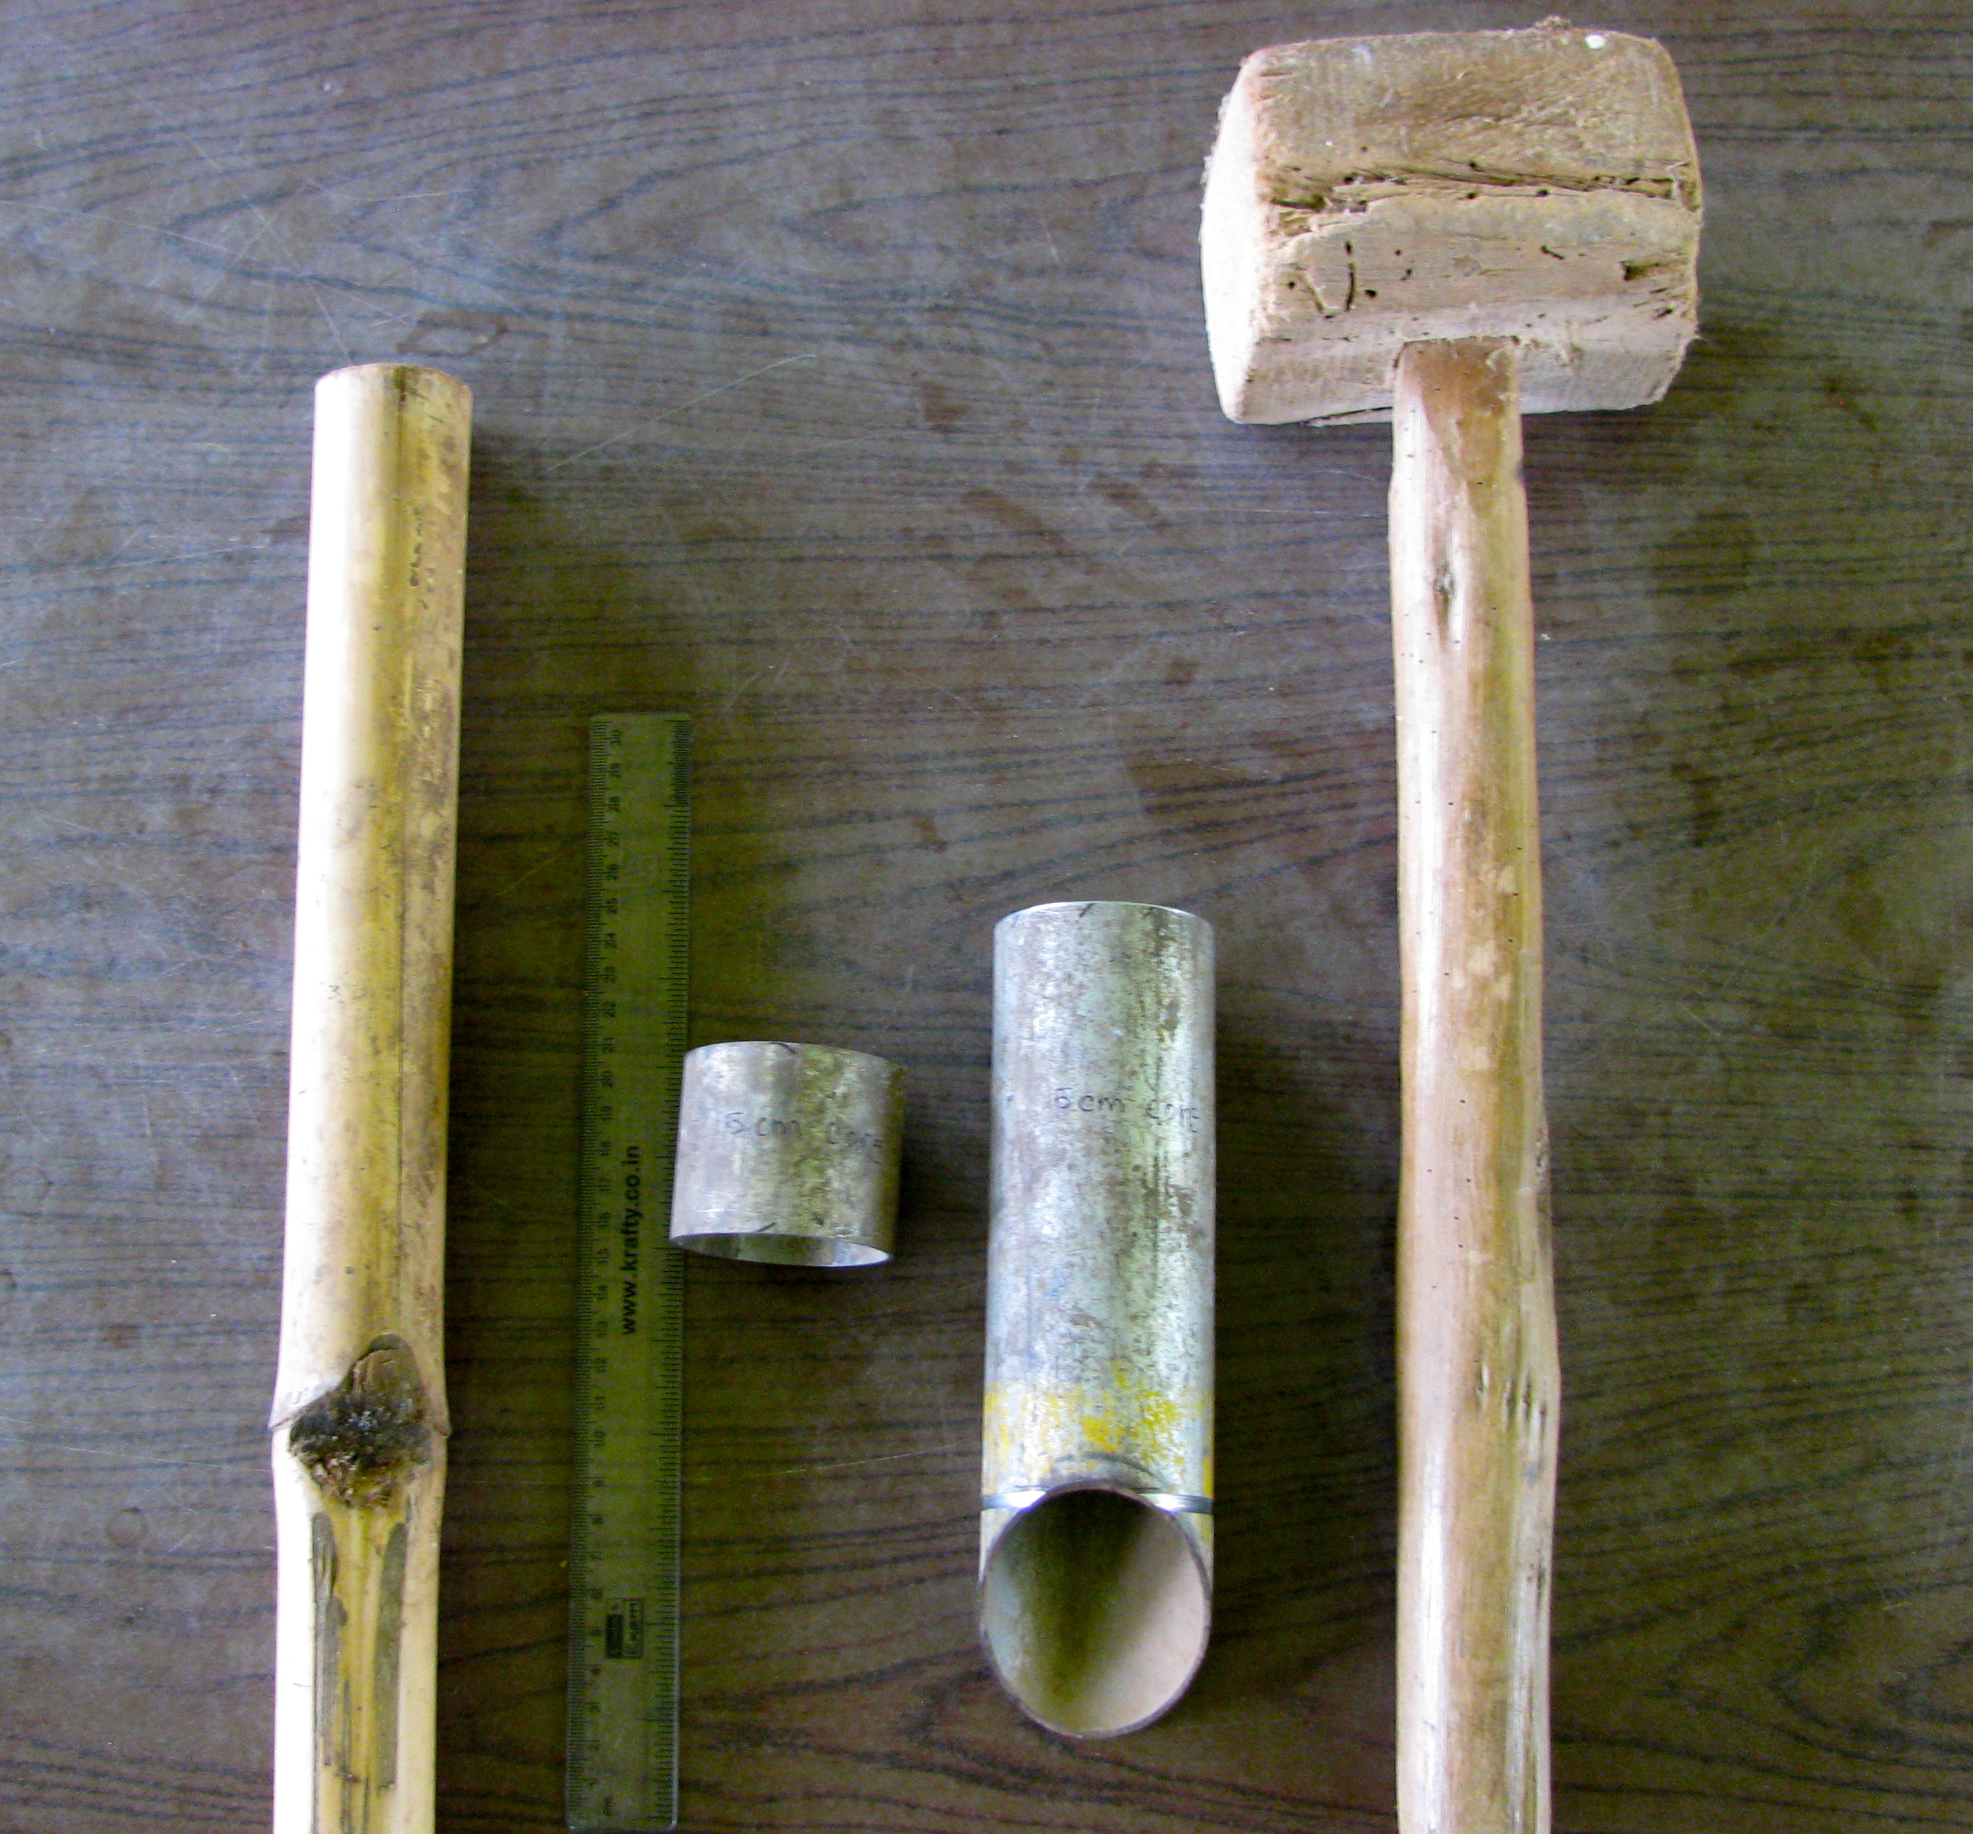
Data Collected: Experimental Trials
Soil core samples were collected at two depths (0-5 and 0-15 cm) to assess pH and bulk density
Prior to sowing
At the end of the cover crop season
Yields of maize and cowpea were also collected and measured

Slide 8
Methodology: Socio-economic survey
Surveys were conducted through face-to-face interviews with household heads
A random sample from 148 households in three villages (Tentuli, Saharpur, and Gopinathpur) in Kendujhar District were surveyed
Data collection methods were both qualitative and quantitative

Slide 9
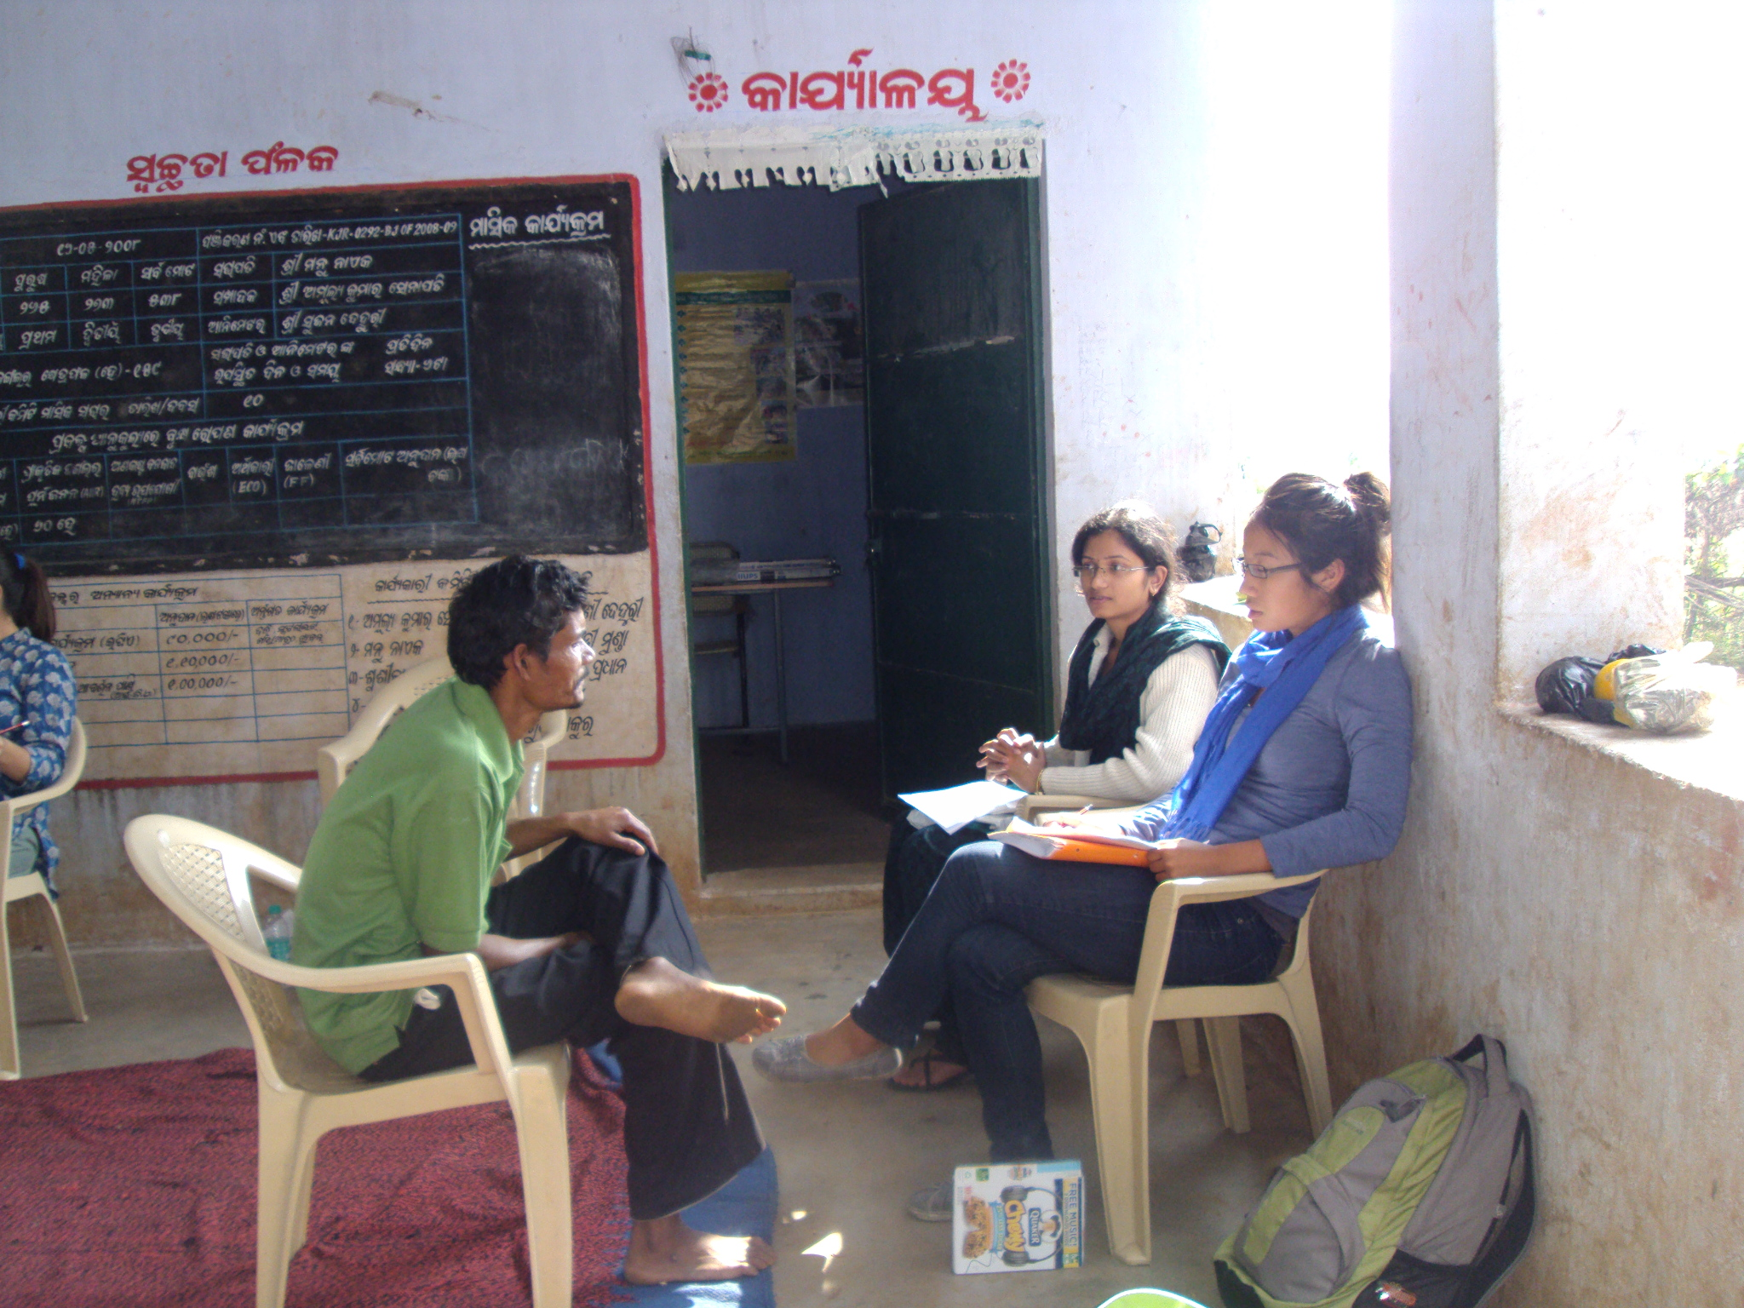
Socio-economic survey
The questionnaire consisted of 6 sections:
Family profile/Demographics
Household assets
Land and input use
Labor use
Agricultural output
Market transactions

Slide 10
Methodology: Socio-economic survey
A representative farm household model was developed from survey data to establish common practices, farming systems, and related expenditures
The data was also used to construct representative maize-based production budgets to reflect the monetary and labor costs, and total revenues for the different CAPS treatments

Slide 11
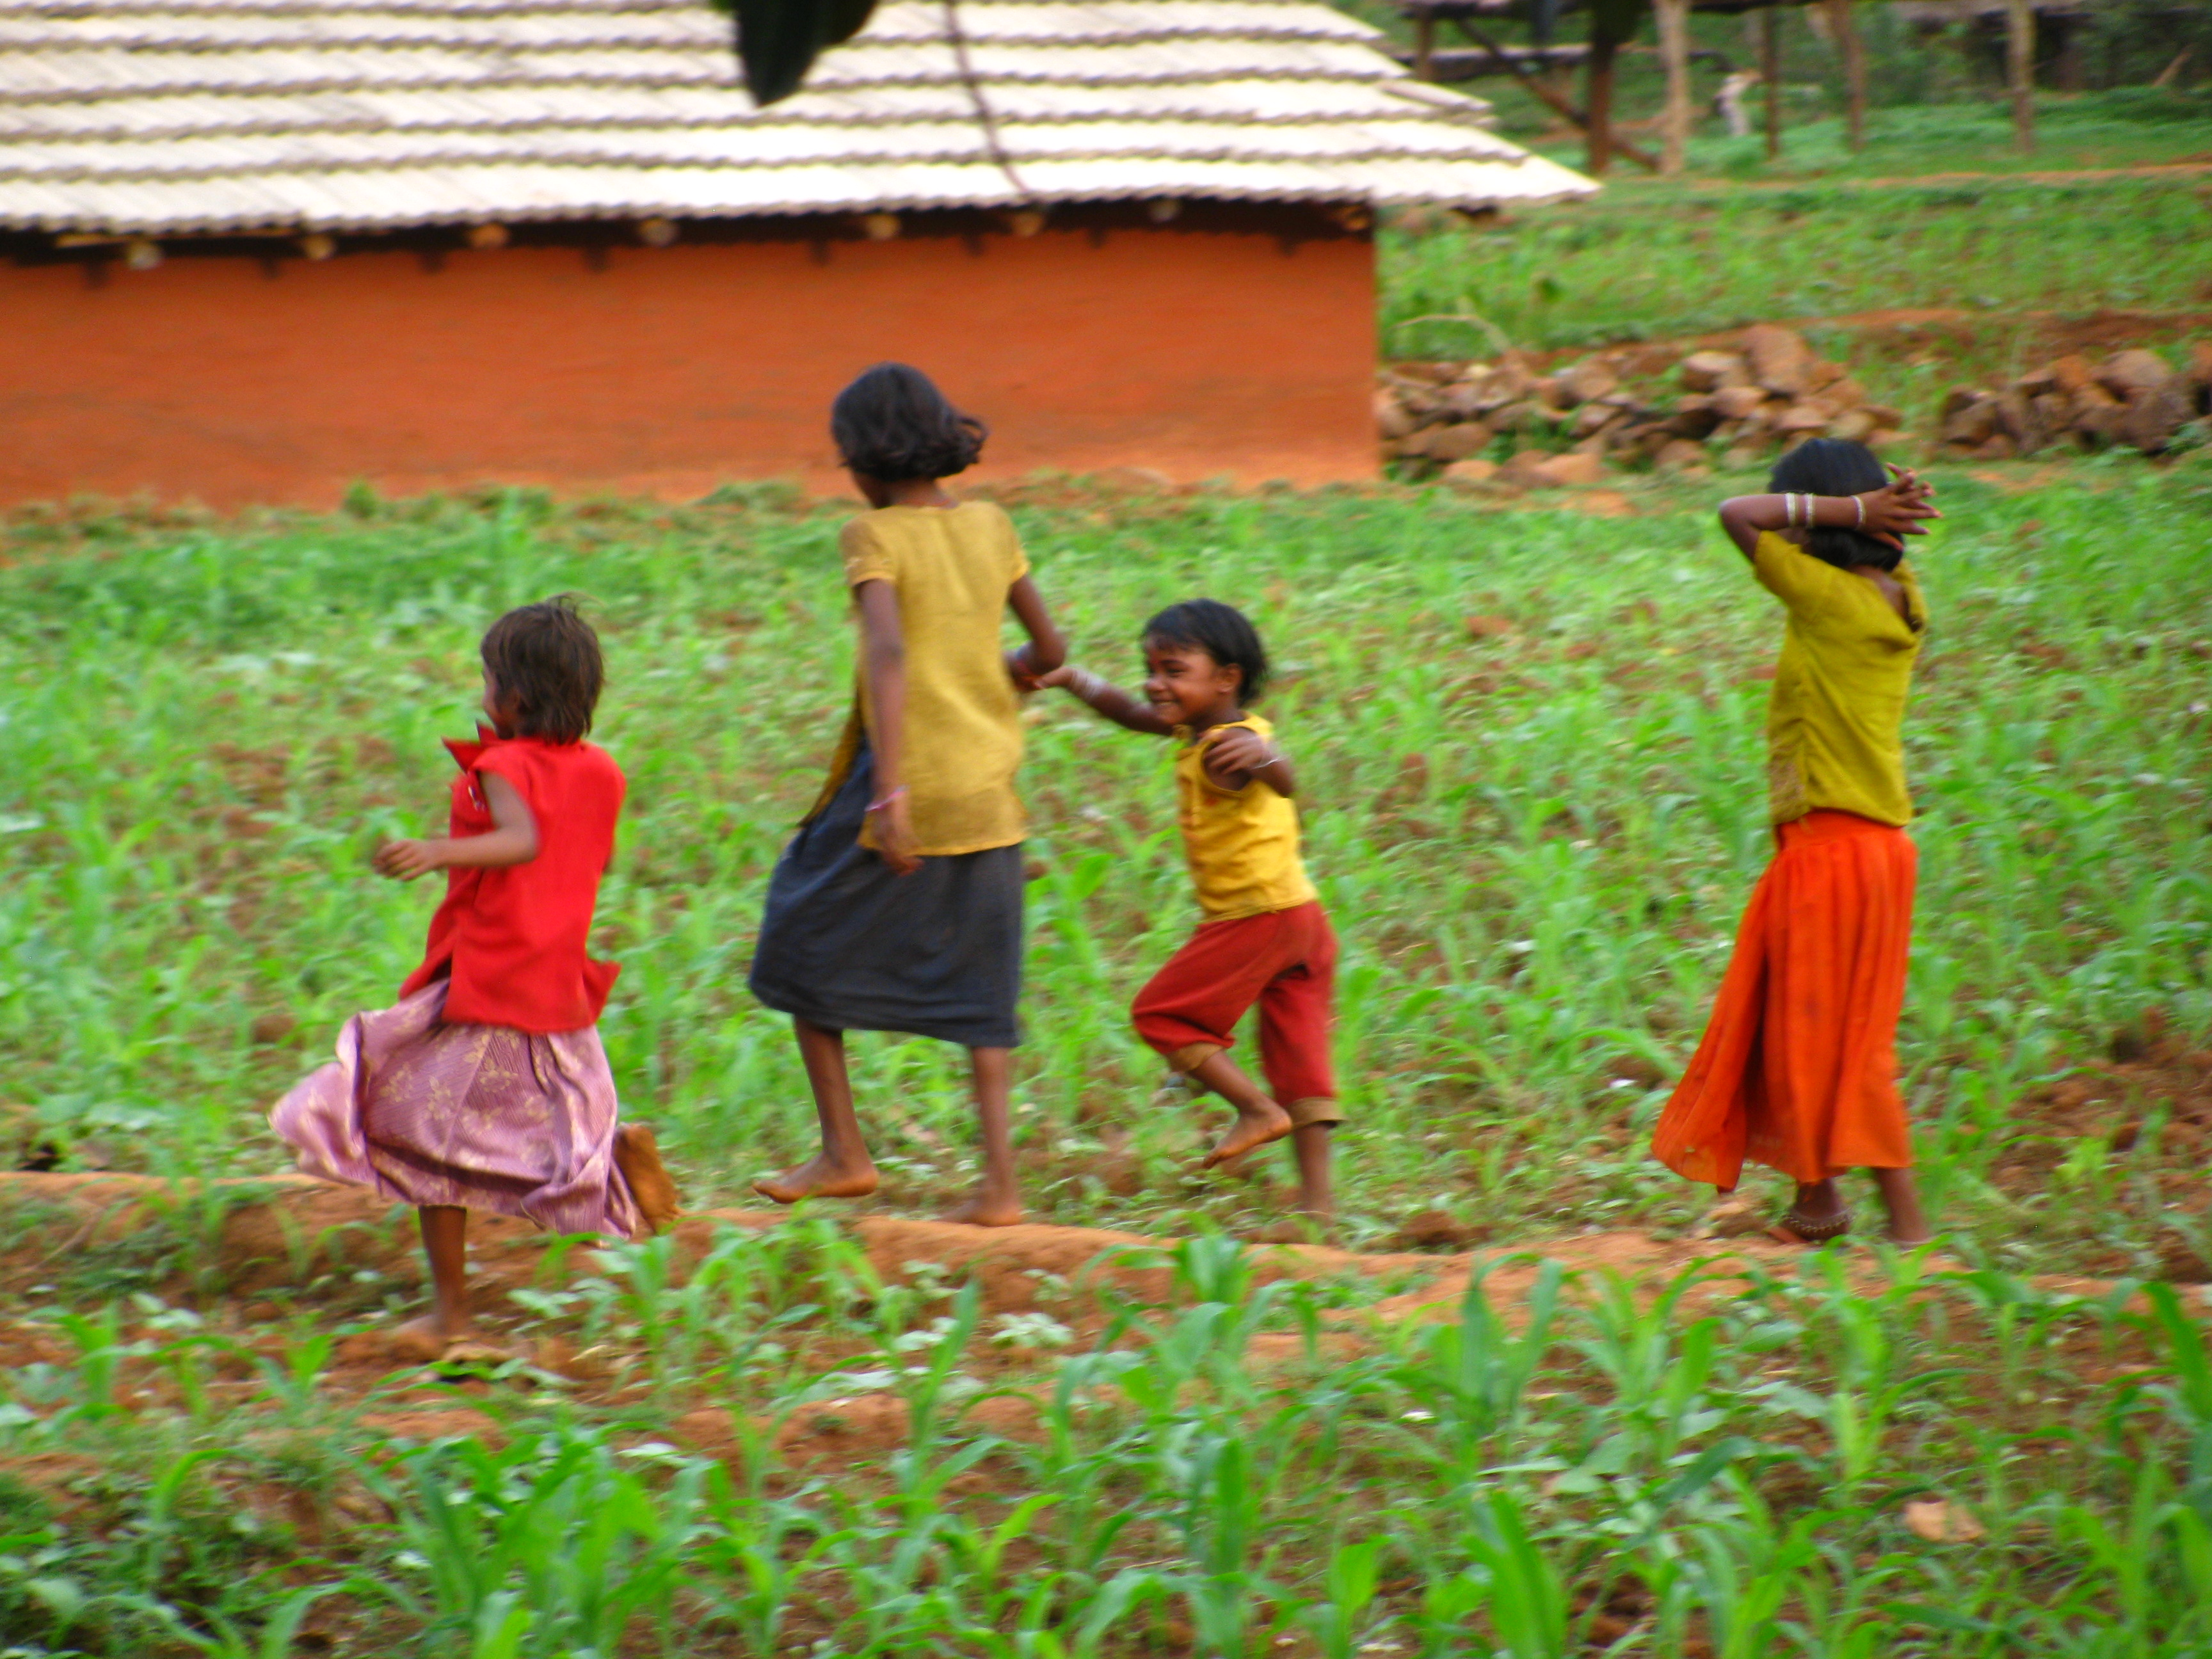
Results & Discussion

Slide 12
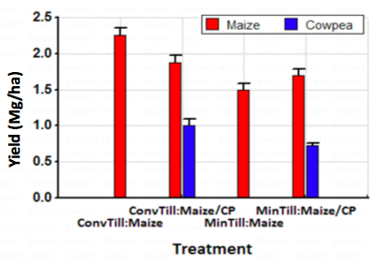
Effect of reduced tillage & intercropping on crop yields
Of the CAPS treatments, introduction of intercropping had the highest maize yield (1.88 Mg/ha), followed by the introduction of reduced tillage with intercrop (1.70 Mg/ha)

Slide 13
Results: Crop yield
Intercropping and reduced tillage treatments resulted in losses to maize yields, as compared with traditional farming methods
Maize yields are expected to be reduced during the initial years of minimum tillage implementation (Monneveux et al. 2006)
Intercrop treatments had the addition of high-protein, high-value cowpea yields (1.0 & 0.73 Mg/ha) to offset the initial losses in maize production

Slide 14
Effect of intercropping with cowpea on soil pH
Increase in pH was most prevalent in intercropped treatments
Optimal range for maize: 5.4-5.9
pH of intercropped plots was raised, on average, by 0.1after a single cropping season
Mono-cropped plots had an average pH increase of 0.02

Slide 15
Effect of horse gram (M. uniflorum) cover crop on bulk density
c
c
c
d
1.336 g/cm³
a
a
a
b
Optimal bulk density (<1.32 g/cm³) for maize is approached at 0-5 cm with cover crop treatment
Increased root penetration & SOM from the cover crop significantly reduced bulk density

Slide 16
Farm household model
47% produced maize solely for household consumption
53% sell approximately half of the maize yield

Slide 17
Integrated Model
Developed from the survey and experimental field data on the potential for increased yields, labor requirements, profit, & soil improvements
(Ratings are comparative and indicate most positive, ++++, to most negative, ---)

Slide 18
Conclusions
Introduction of maize/cowpea intercropping showed improvements to soil pH while increasing crop diversity and household food security
Cowpea yields offset the reduction in maize yields in the initial years of CA
Introduction of a post-harvest cover crop decreased bulk density of soil
Overall CAPS treatments displayed positive and negative attributes for the farmer and optimal solutions will vary by household needs

Slide 19
Future Implications
The integrated model can be used in conjunction with Analytic Hierarchy Process farmer preferences surveying to guide the farmer in weighing CAPS alternatives
With this model, improved adaptive management strategies can be developed and the potential for adoption of new practices can be increased

Slide 20
Acknowledgements
USAID/SANREM
University of Hawaii: Dr. Catherine Chan-Halbrendt, Dr. Carl Evensen, Dr. Travis Idol, Dr. Chittaranjan Ray
Odisha University of Agriculture & Technology: Dr. P.K. Roul, Dr. K.N. Mishra, Dr. S. Dash

Slide 21
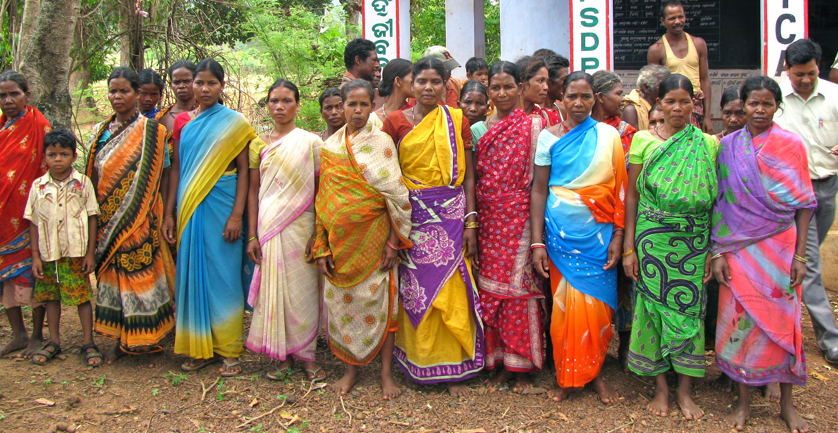
Thank you!

